Slide 1

Redesign Yale School Of Art
Toka Fawzy Mohammed Elhwahi
Section : C2 , no:8

Slide 2
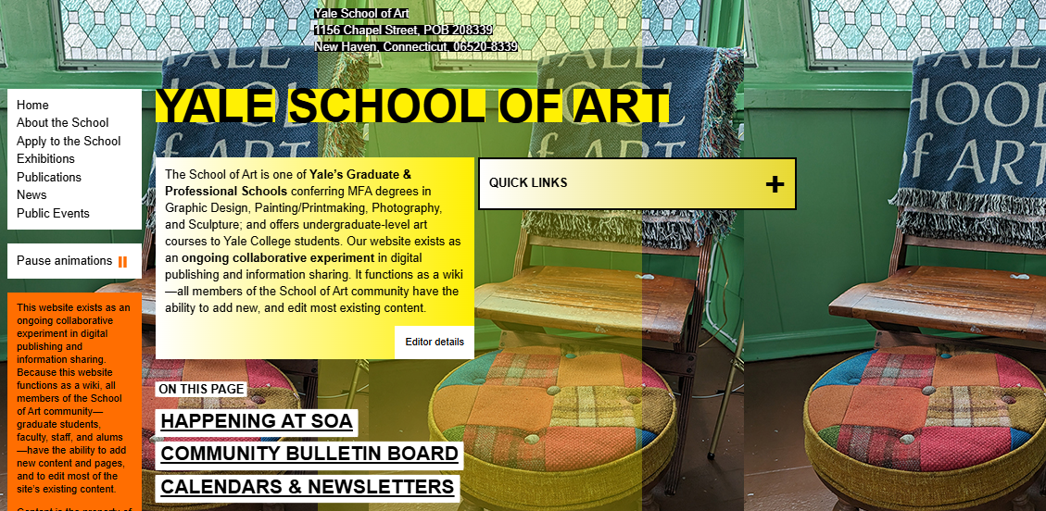
Before

Slide 3


Disadvantage
1
2
3
4
Lack of Visual Hierarchy
Visual Noise
Poor Navigation
Accessibility Issues

Slide 4
Disadvantage
5
6
7
8
Not Responsive
Lack of Branding
Misleading Links
Sacrificing Functionality for "Art"

Slide 5

After

Slide 6
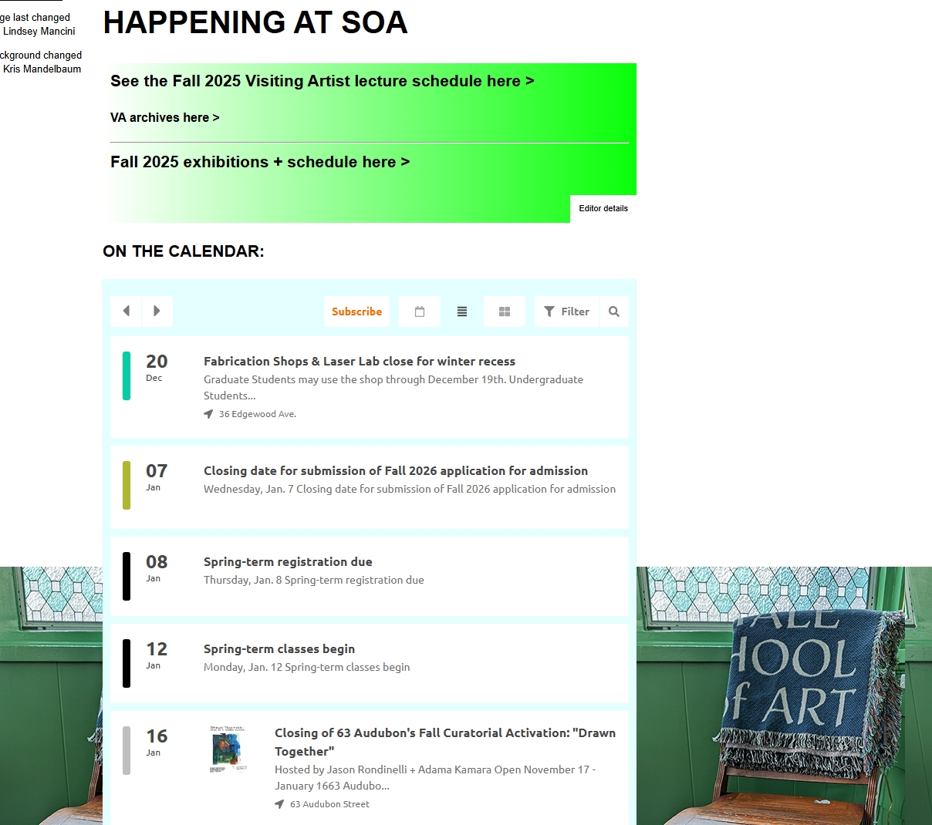
Before

Slide 7
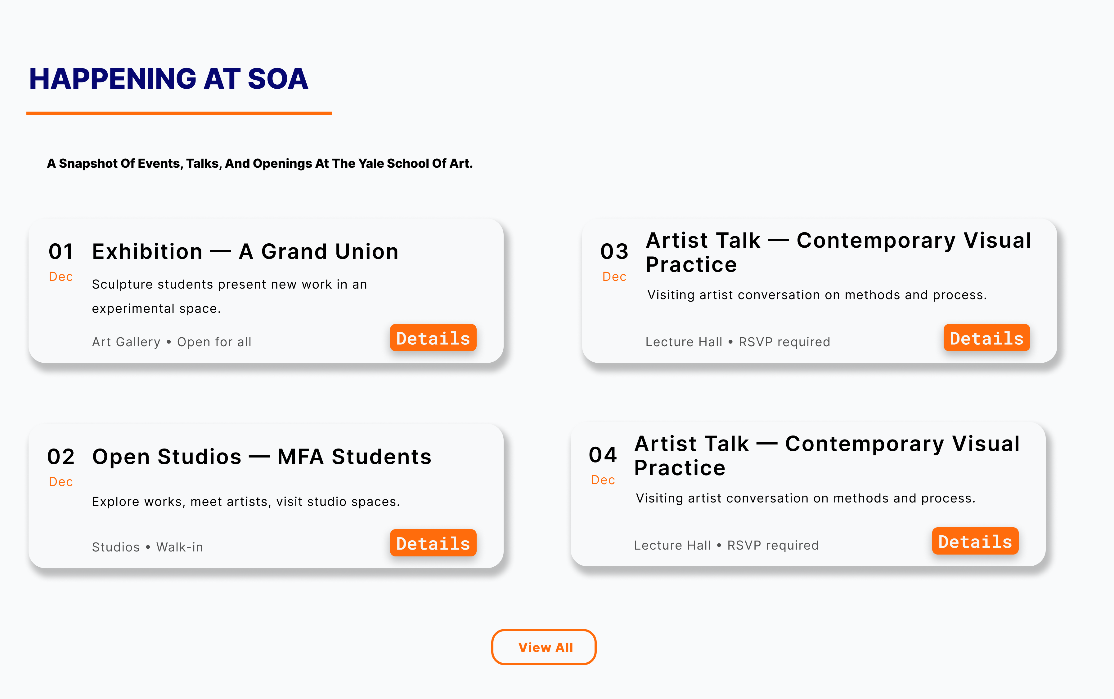
After

Slide 8
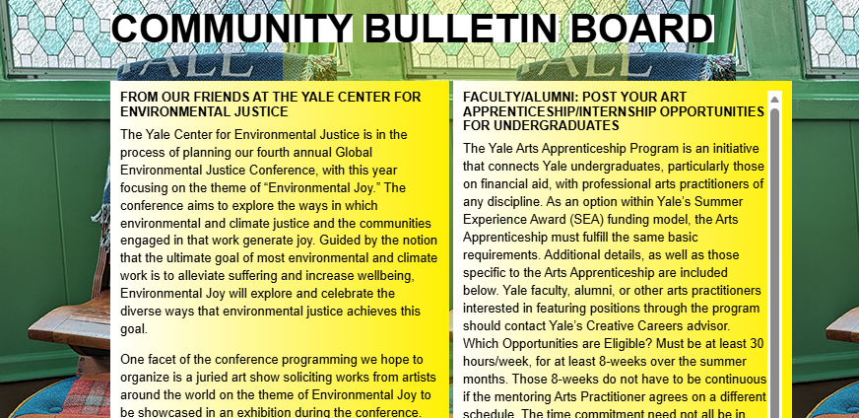
Before

Slide 9
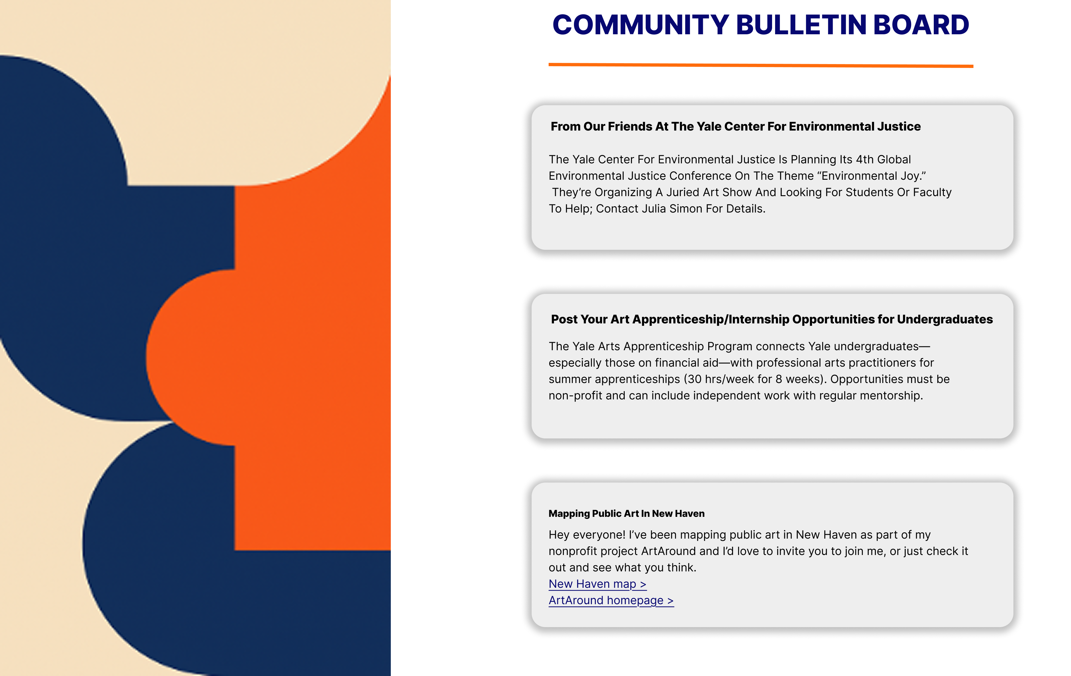
After

Slide 10
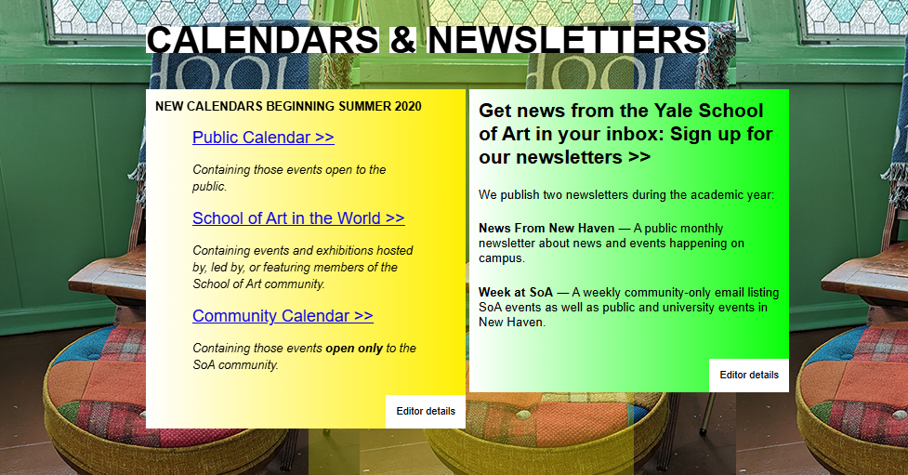
Before

Slide 11
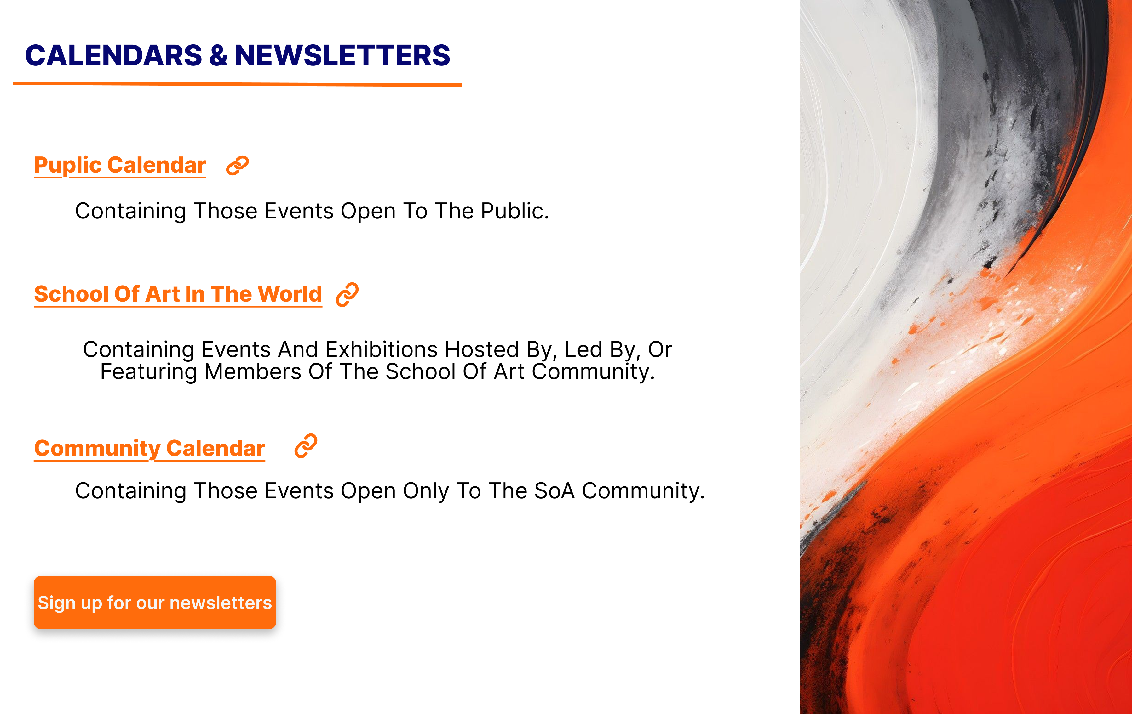
After

Slide 12
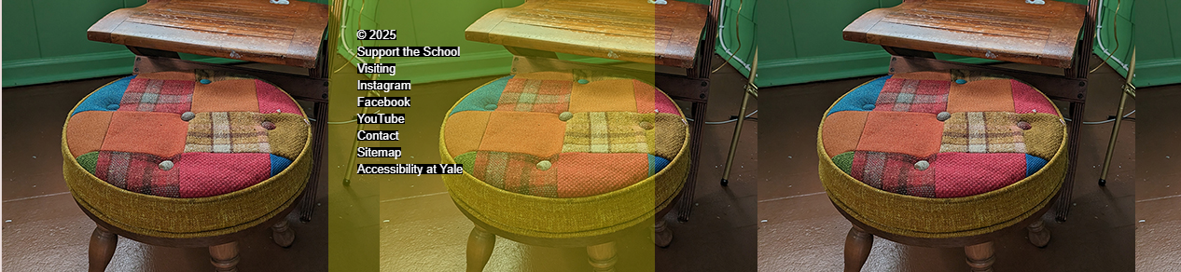
Before

Slide 13

After

Slide 14
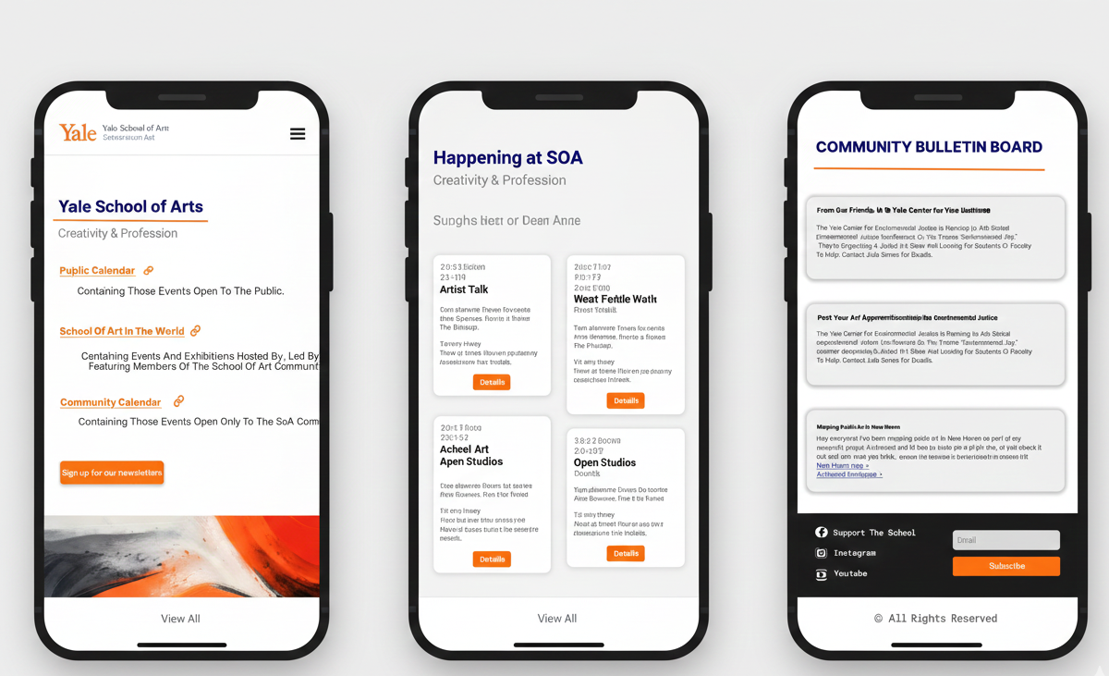
Mobile Responsive

Slide 15


